Slide 1
Teaching Children Faith and Science: A survey of approaches
J. Lewis
NZCIS Seminar
18 March 2021
Notes:
8

Slide 2
Creation Dance
Joy Cowley
In the beginning, God the dancer
Danced the dance of love,
Filling up the emptiness of waiting with her rhythm.
She danced out the universe,
Twirled the stars and planets,
Held light and dark in either hand
And clapped them into wisdom.
And everything moved in a circle of love,
a circle of love, a circle of love.
And everything moved in a circle of love
and God saw that it was good.
Then God danced the mountains up
and trod the seas deep down.
She creased the land for rivers,
Made river to hug the land.
Everywhere her footsteps went,
The earth broke into green
Flax and fern and tree and vine,
Dancing to the rhythm of love.
And everything moved in a circle of love,
a circle of love, a circle of love.
And everything moved in a circle of love
and God saw that it was good.
When the earth was filled with the music
of every kind of creature,
God danced two people into being
And named them woman and man.
She sang to them, “My children,
Join me in creation.
Come and be my partners
dancing the dance of love.”
And everything moved in a circle of love,
a circle of love, a circle of love.
And everything moved in a circle of love
and God saw that it was good.

Slide 3
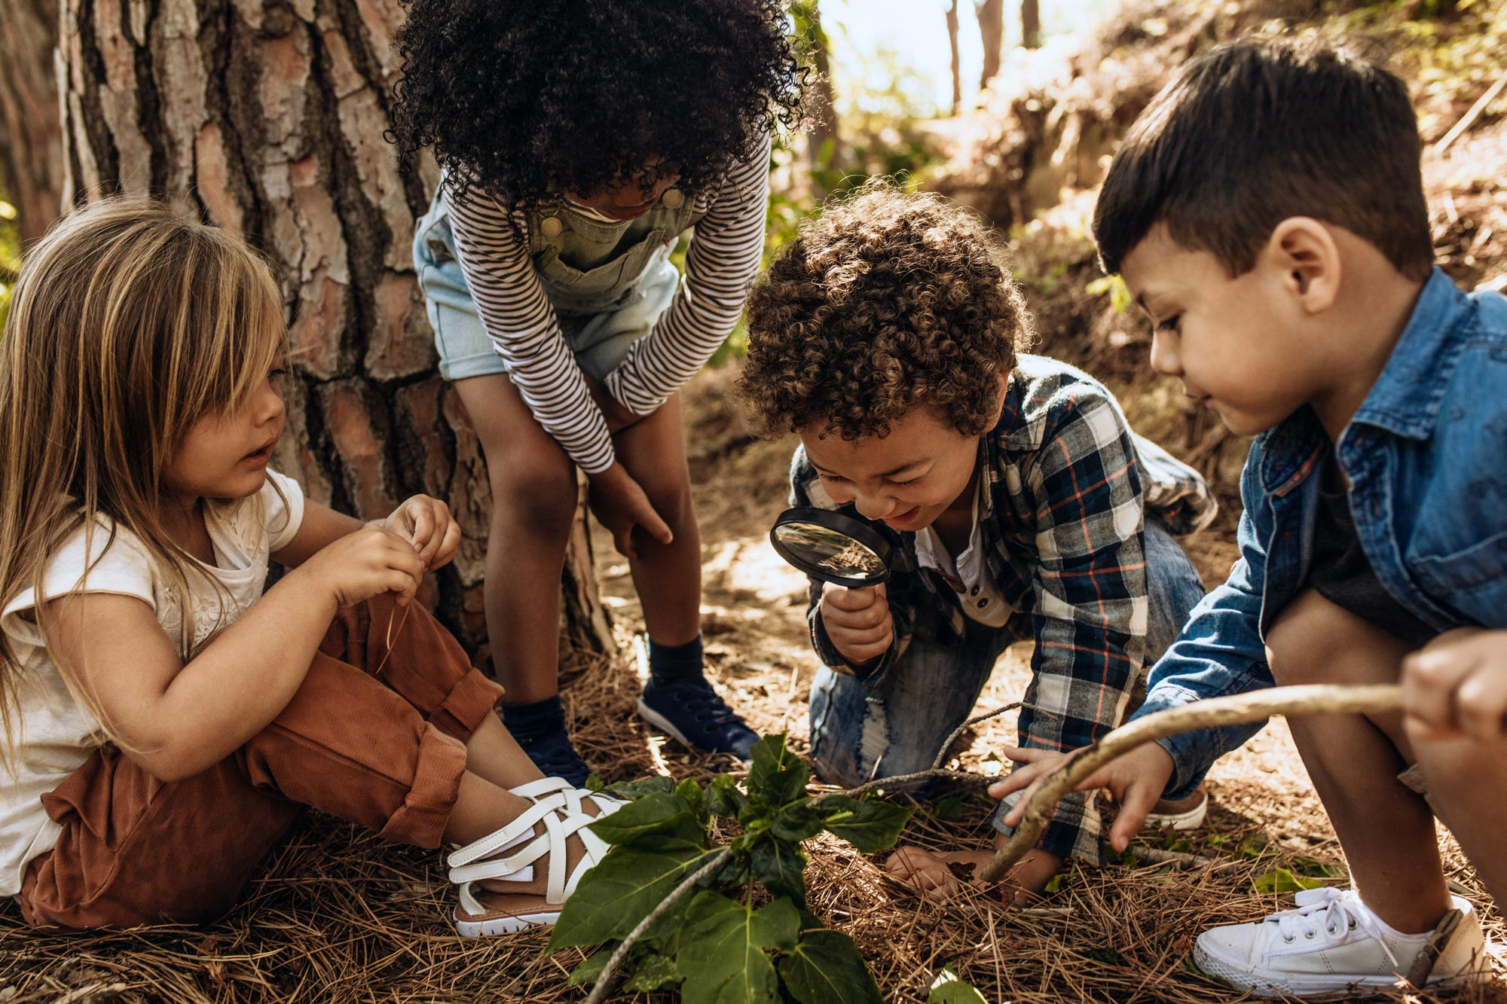
Foundations
Teaching
Exploring big questions together
Children
Intrinsic spirituality, curiosity, sense and meaning-making
Faith and Science
Faith - orientation to life characterized by openness to God and the sacred beyond us, within us, among us and our world
Science - shares a basic orientation of faith in the order of the cosmos
Religious Education Metaphors
guide and companion exploring the one house of heaven and earth
facilitator of revelatory experiencing and communion with God and earth
listening to God and earth together
Notes:
Foundational Assumptions
Teaching
Not passing on content
Exploring big questions together – religious traditions and scientific traditions raise big questions and seek to respond to them in different ways
Children
intrinsic spirituality
inherent curiosity
natural proclivity for sense-making and meaning-making
Faith and science
Faith – orientation in life characterized by openness to God and the sacred among us, in our world
Segundo – faith is learning to learn, faith is always “in process”; faith is an “ideology” or a situated perspective that bears an inherent relationship to one’s situation, historical context, and culture and is open to continued transformation,
Faith is a response to the sacredness of the world; it is an expression of hope
Faith speaks many languages
Science – shares a basic orientation of faith in the order of the cosmos
Method of investigation
Only information that is “falsifiable”
Important:
Neither are “pure”; both are modes of investigating the world, reflecting on who we are, where we come from, our place in the world, the relationships we have with one another and the earth, that bear the fingerprints of our contexts, positions
Teachers are non-experts
Hermeneutical perspective – mutual, critical, (re)constructive conversation between interpretations of the Christian tradition and interpretations of findings from scientific disciplines (Tracy)
Identity
Analogy
Non-identity

Slide 4

Practical “Organic” Approach
Starting with:
The questions kids ask
Pressing, current issues
Developmental concerns
Experiences and settings
Creating conversations between:
Religious symbols and stories
Earth symbols and stories
Religious and scientific ways of exploring questions

Slide 5
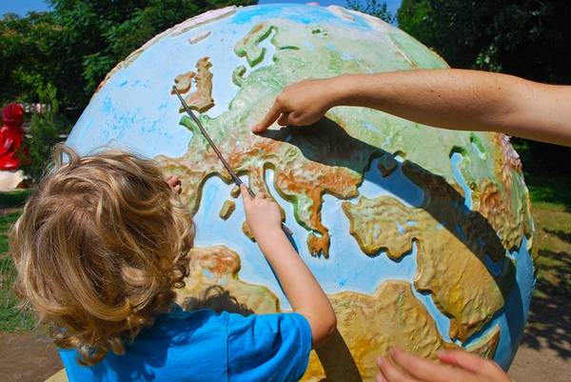
Integrative approach:
Deep Time Network
Five Principles:
Context - orient to a vast, evolving universe
Matrix - understand our embeddedness in the Earth
Transformation - experience inner growth and engagement
Action - participate in evolution to create a vibrant world
Continuum - link deep time learning across all stages of life
Notes:
Five principles: context, matrix, transformation, action, continuum
Draws on Ignatian Pedagogy – moves from Context to Experience to Reflection to Action to Evaluation
Context – orient to a vast, evolving universe – foundational connective tissue
Helps learners discover their own identity and role in the larger context
Methods - Creation stories, artistic expression of a narrative, histories of transformation
Teaches that the Universe is unfinished and emerging here and now
Universe is a teacher and guide
Matrix – understand our embeddedness in the Earth
Situating the earth story within the larger story of the cosmos
Methods – experiencing and directly interacting with nature, using body and senses
Teaches interdependence, symbiosis, identity as forged within a web of relationships
Transformation – experience inner growth and engagement –
Because:
it’s the place where deep learning and fulfillment happens and can impact an individual’s future
interiority, or inner experience, drives action and therefore the future of evolution.
A goal of DTL is to nurture a person toward greatest fulfillment and toward contributing to evolving the Universe.
awe and wonder -
connection – bonding deeply with others and the larger whole
imagination – imagining future possibilities
reflection and discernment
passion, place and purpose
Action – participate in evolution to create a vibrant world
DTE recognizes that an understanding of context; matrix; and inner transformation can lead to action that brings about emergence, thus evolving the Universe.
Cosmology has two components: 1) an origin story and 2) a guide to action, or how to relate to others/ Earth/Cosmos. This second component in cosmology is often called “right relationship.
There is an understanding in DTL that a flourishing future depends on our cosmology— our understanding of our origin, and “right relationship” with Earth/Cosmos and each other. Most members of the Network would subscribe to the idea articulated by Thomas Berry that right relationship is one in which humans and Earth have a “mutually enhancing relationship.”
Continuum – link deep time learning across all stages of life
Deep Time Education works as a continuum across all levels, tied to stages of development over our lifetimes. It flows from level to level like a spiral moving toward expanding levels of understanding, experience, love and action.

Slide 6
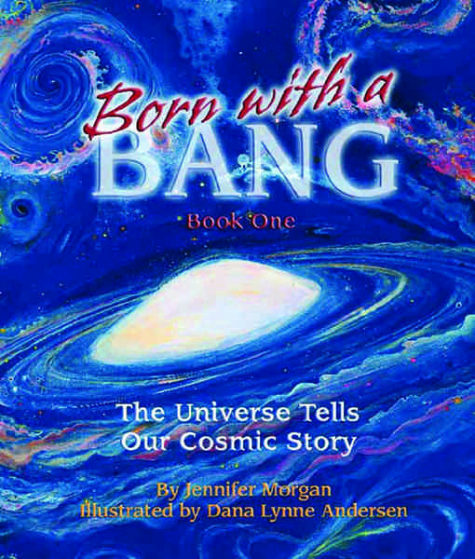
Narrative approach:
Montessori Method
Cosmic Vision - way of seeing and understanding the world as a complex, interdependent unity
Cosmic Plan - there is a cosmic order at the level of nature that depends on many cosmic agents, each with a particular task to fulfill
Cosmic Education - becoming aware of the different kinds of cosmic work carried out by the various agents and of the interdependencies and interrelationships involved; developing one’s own cosmic vision; becoming conscious active participants ourselves
Cosmic Work - anything in the universe does to contribute to the greater good, most often unknowingly
Examples: God Who Has No Hands; The Story of Life

Slide 7
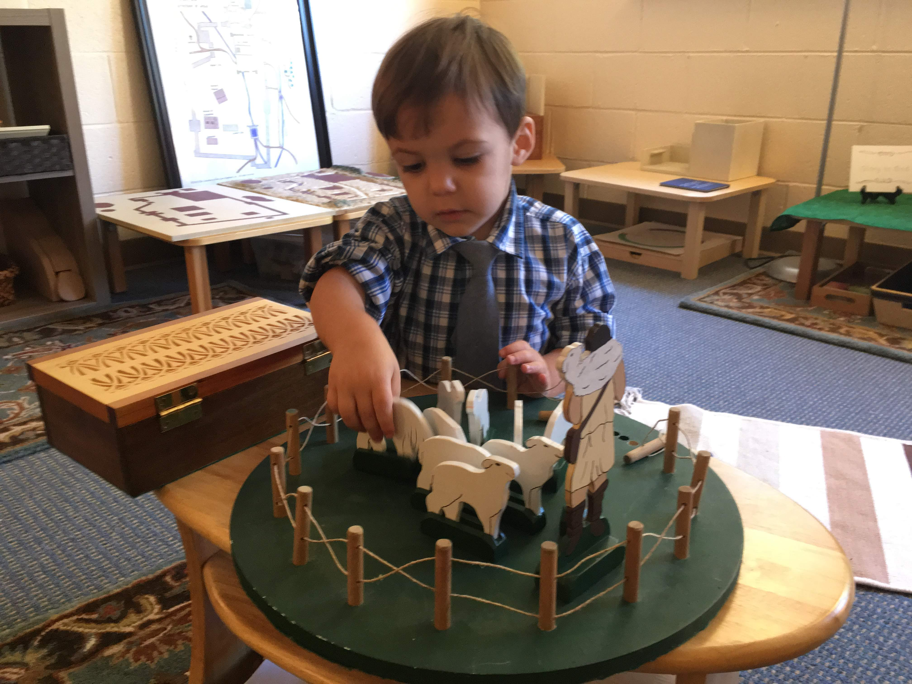
Religious work Approach:
Good Shepherd Curric.
Educator - Religious leaders must come to view education “as an aid to Life itself”; they must cultivate the spirit of a scientist; listening together with children and honoring their creative impulses
Atrium – spiritual environment in which children and adults can together respond to God
Materials - give tangible expression to “religious realities, both from the Bible and the liturgy
Work - children work with passion and exhibit qualities akin to explorers and scientist; their work participates in a cosmic mission
Prayer – means of God’s self-revelation to us and our response to God; need to foster conditions of reverence and silence
Notes:
Educator - Religious leaders must come to view education “as an aid to Life itself”; they bring the environment to life; educators must cultivate the spirit of a scientist; listening together with children; honor their creative impulse
Materials – materials serve as helps to the teacher and give tangible expression to “religious realities, both from the Bible and the liturgy” (20, 24). The purpose and use of materials in “catechesis” are to lead the child into prayer (20), as well as “self-control, concentration, reasoning and reflection” (24)
Atrium – spiritual environment in which children and adults can together respond to God
Work – children work with passion and exhibit qualities akin to explorers and scientist; their work is joyful, sustainable, and links us to all other living creatures who are also engaged in the work of healing and nourishing others; this work has a shaping and ordering power to cultivate the child’s curiosity and appreciation of the world
Prayer - Prayer is the avenue by which we “listen to God” and enter into the mystery of God; everything in the atrium ought to prepare “within the child a fertile ground for prayer” (130) and “springs from its being a place of prayer: a place of listening and responding to God, a place where work and study spontaneously become meditation, contemplation and prayer

Slide 8

(Christian) Contemplative Eco-pedagogy
Contemplative orientation
“Long loving look at the real” – Walter Burghardt
Science as a medium of and path to prayer
Contemplative postures
Eco-theological Frame
Cosmic vision of the universe in God
Example: theology of creation
Pedagogy – monastery of the earth
Practices - Ecclesial practices, spiritual practices, life practices (sacramental cosmic work)
Contexts/topics – starting with land, place, religious questions
Mediums – poetry and art; stories, narratives, parables; experiences with bodies, nature
Notes:
Contemplation/Contemplative Prayer
Prayer – all religious education should lead to prayer (Gobbi); all (religious) education can lead to and itself be a form of prayer
Science can be a form of prayer, and it can lead to prayer
Walter Burghardt – contemplation is a long, loving look at the real
Contemplative Postures for Religious and Scientific Discovery
Humility
Curiosity
Attentiveness
Openness
Generosity
Delight
Ecological
Recognizes and honors the integrity – the oneness or wholeness – of the universe
Foregrounds human-earth interdependence
Cosmic vision of the world in God
Theological Frames: Example of Creation
Earth as our body
Earth as God’s body
Air as God’s breath, oceans as God’s belly
Earth and universe as oikos; household rules and responsibilities
Earth creatures as our brothers and sisters
Pedagogy
Ecological, scientific literacy and exploration
Ecological justice and earth care
Empathetic connection with earth
Developmental concerns/settings – starting with kids’ questions and practical issues
Bodies
Nature
Emotions
Independence and order
Interdependence and diversity
Religious topics and themes – arenas for conversation between religious and scientific stories
Eco-theological anthropology
Salvation as cosmic
Communion with the whole world
Relationality
Mediums for exploring the relationship between science and faith
Poetry and art
Stories, parables, narratives
Activities – bodies, nature interactions, places
Ch. 3 – Religious Education for Inhabitance
How do we help people become good ecological beings; how do we lead them toward ecological conversion? – pg. 39
Ecological religious education is not just about becoming better ecological beings; it is about becoming more human – pg. 40
“To embrace wonder, to risk full-hearted love, to grieve and repent harm, to find hope in struggle – all of these dispositions are as fundamental to human life and meaning as they are to the planet’s ecological challenges. Religious education that cultivates these dispositions among people of faith and within faith communities is process of formation and transformation for a “good life.” – pg. 40
“Certainly, a vibrant and resilient ecological faith – a faith that turns on the capacities necessary to inhabit God’s world well; a way of life seeking to become loving, just, and responsible members of God’s household – is a primary indicator of the good life.” – pg. 40
The problem is that we need practical theological approaches to cultivating the kind of transformation of consciousness that ecological theologians and ethicists identify as crucial to ecological sound living
Recognition that religious and spiritual language can help anchor some of the “intangible, numinous aspects of environmental education,” as well as awareness of the critical roles of emotion and imagination in developing ecological understanding. People speak of the ecologically-conscious person in terms of “wonder, mystery, reverence, and prayer” – pg. 42
“Environmental education, then, should cultivate these disposition, and this poses an urgent call to practical theologians, and in particular, religious education to excavate their religious traditions for the sources that might

Slide 9
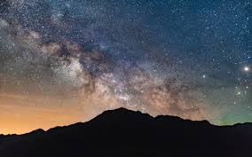
Faith and Science: Contemplating the World in God
Scientific explorations in context of faith as gateways to boundary questions, limit experiences, negations, illuminations and communion
Boundary questions:
“Why is…?” questions: why are humans here? Why is the sun sunny? Why do seeds grow? Why do people die?
Limit experiences:
Ecstasy and illumination
Amazement and mystery
Awe, wonder, reverence
Praise and gratitude
Peace and hope

Slide 10
A Song of Creation
Joy Cowley
Oh, my Creator,
I can’t take it in.
My mind won’t wrap around it,
My breath is hushed with awe
As I consider this being you have made,
This delicate machine, this I.
I can’t guess how old the universe is,
Billions and billions of years,
But I do know that every element
In this body of mine, has existed
From the very beginning.
Way back, when this earth was a ball of fire in the void,
The components of my being were as much there with you,
As was my soul, oh God.
Every atom of me that is now,
Was also then.
And I know that in the entire history of this amazing universe,
There has never been another creation
Exactly like me.
Nor will there be another me,
Ever again.
I am one of a kind.
Oh God, when I think about that,
I feel faint with wonder
And gratitude.

Slide 11
Singularity
Marie Howe
(after Stephen Hawking)
Do you sometimes want to wake up to the singularity
we once were?
so compact nobody
needed a bed, or food or money—
nobody hiding in the school bathroom
or home alone
pulling open the drawer
where the pills are kept.
For every atom belonging to me as good
Belongs to you. Remember?
There was no Nature. No
them.
No tests
to determine if the elephant
grieves her calf or if
the coral reef feels pain. Trashed
oceans don’t speak English or Farsi or French;
would that we could wake up to what we were
— when we were ocean and before that
to when sky was earth, and animal was energy, and rock was
liquid and stars were space and space was not
at all — nothing
before we came to believe humans were so important
before this awful loneliness.
Can molecules recall it?
what once was? before anything happened?
No I, no We, no one. No was
No verb no noun
only a tiny tiny dot brimming with
is is is is is
All everything home

